Slide 1
Analyzing Housing and Income Data for MLB Expansion
Team 116

Slide 2





The Team
Josh Mayanja
Yutai Liu
Warren Spann
Anthony Palmeri
Jonathan Martin
Solutions Consultant, Nuix NLP
Project Analyst, Insight
Enterprise Data Analyst
Data Analyst, Business Intelligence
Business Intelligence Consultant

Slide 3
The Problem

Slide 4

Problem Overview
MLB is exploring expansion
Our goal is to predict attendance for potential markets
Finding ideal markets is difficult
Multiple new markets could look similar on paper
Could be non-traditional markets being overlooked that are actually the best option
Multiple stakeholders with billions of dollars on the line
Cost to start a new team is at least $2.2 billion (1)
A successful franchise will generate in billions
A failed franchise would ravage the entire market
“Manfred’s $2.2 Billion MLB Expansion Fee on the High Side, at Least for Now.” Yahoo!, 3 May 2021, www.yahoo.com/video/manfred-2-2-billion-mlb-095515953.html?guccounter=1&guce_referrer=aHR0cHM6Ly93d3cuZ29vZ2xlLmNvbS8&guce_referrer_sig=AQAAAL4a-Ocq4BcSf9OQjHqZzT_TUBzNgWfTWI1znfMU-XRHCRKFRBDSMr87D5_kfj5osaPpcAUjoYWM2yv-IKoNwkQdMctGDvCDo9A3aLa_6V6A5JMpCs5m5snATtr86dIyqnUvAbcOKBY9lGeG6zouW-LyF22CXiElkV3rUIOuFfBA#:~:text=Major%20League%20Baseball%20commissioner%20Rob,be%20at%20least%20%242.2%20billion.

Slide 5
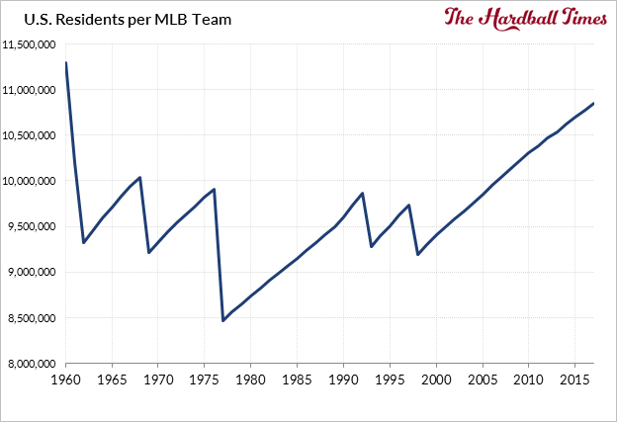
https://tht.fangraphs.com/tht-annual-2018/mlb-needs-to-expand-heres-where/

Slide 6

Primary Research Question: Can MLB attendance be predicted based on income data?

Slide 7
Planned Approach

Slide 8
Planned Approach
Take housing income data as well as data to try to predict attendance for an MLB market.
Utilize a linear regression model to do this, and potentially a few clustering models to group together similar markets.

Slide 9

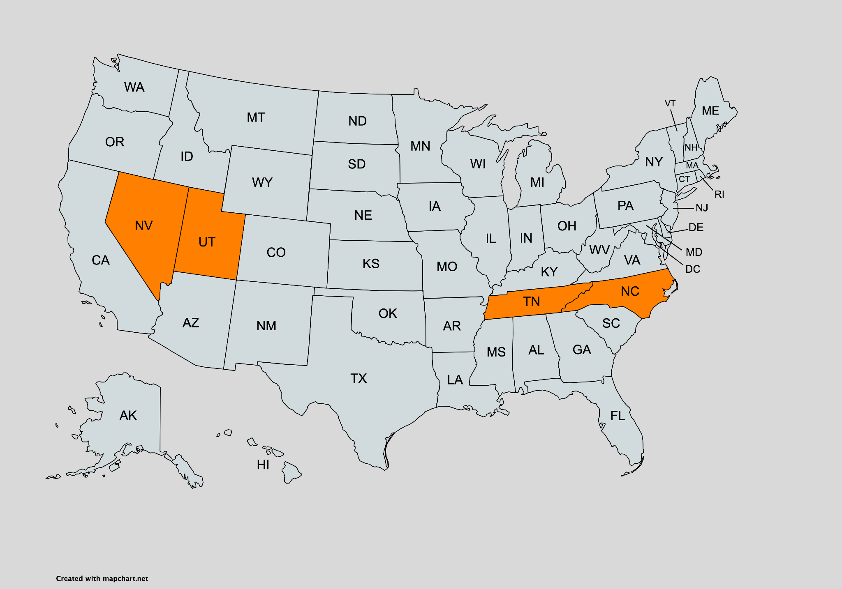
Initial Hypothesis
We believe our model will predict one of four cities to have the highest attendance numbers
Nashville, TN
Charlotte, NC
Las Vegas, NV
Salt Lake City, UT
Tens of potential markets across the United States will be tested
Would not be surprising if our model forecasted a non-traditional market to have the highest attendance

Slide 10
Models
Regression Model
We will use 20 markets to train our model, and the remaining 10 markets to test.
After training, we will remove all statistically insignificant predictors to optimize the model.
Used to forecast attendance for each new market
Inputs will include US census income data
Linear Regression, XGBoost, and Neural Networks will be the methods explored
Clustering Model
Used to cluster new markets with existing markets.
Provides each new market with a few current comparisons
Inputs will include market housing income data, and potentially franchise valuations
K-Means, K-Nearest Neighbors, and Hierarchical clustering will be the methods explored

Slide 11
Datasets and Cleansing

Slide 12
MLB Datasets
MLB Attendance Numbers
162 rows (how many games in a season) by 22 columns
Very few NULL values per column
Extraneous columns will need to be removed for analysis
Difficulty combining datasets
MLB Team Valuations
30 rows by 11 columns
No NULL values, so imputation not necessary
Each year is skewed to the right so normalization will be required
(Summary statistics on next slide)
Notes:
Our main focus will be projecting attendance numbers with this data
Main difficulty will be compiling the information together, webscraping or merging manually?

Slide 13
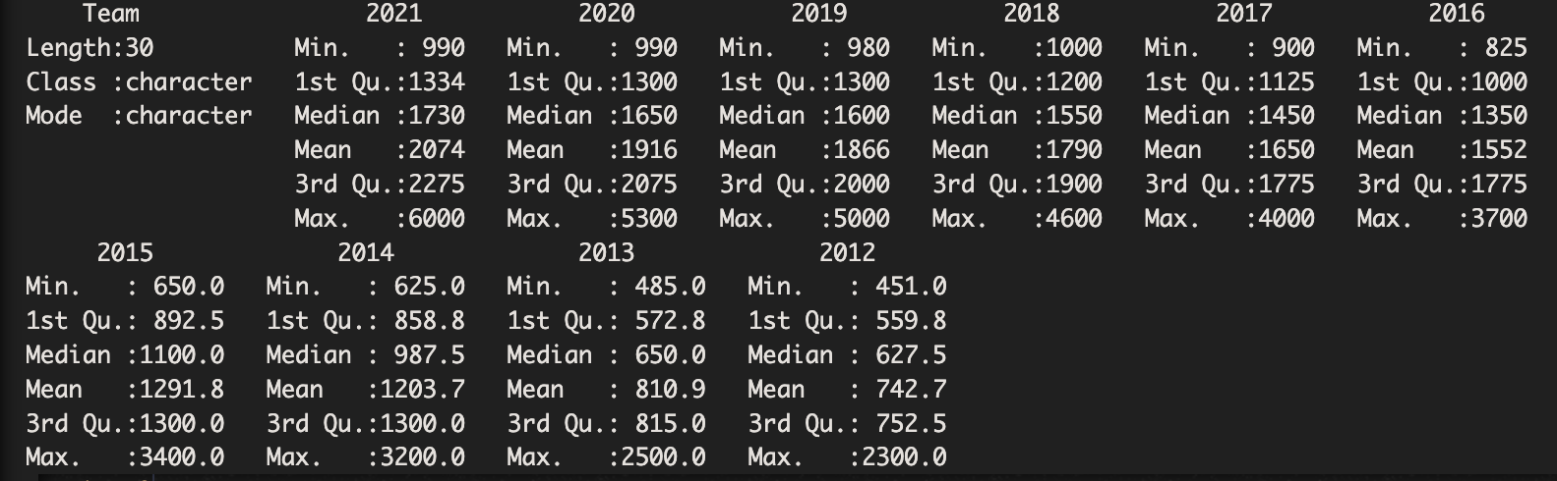
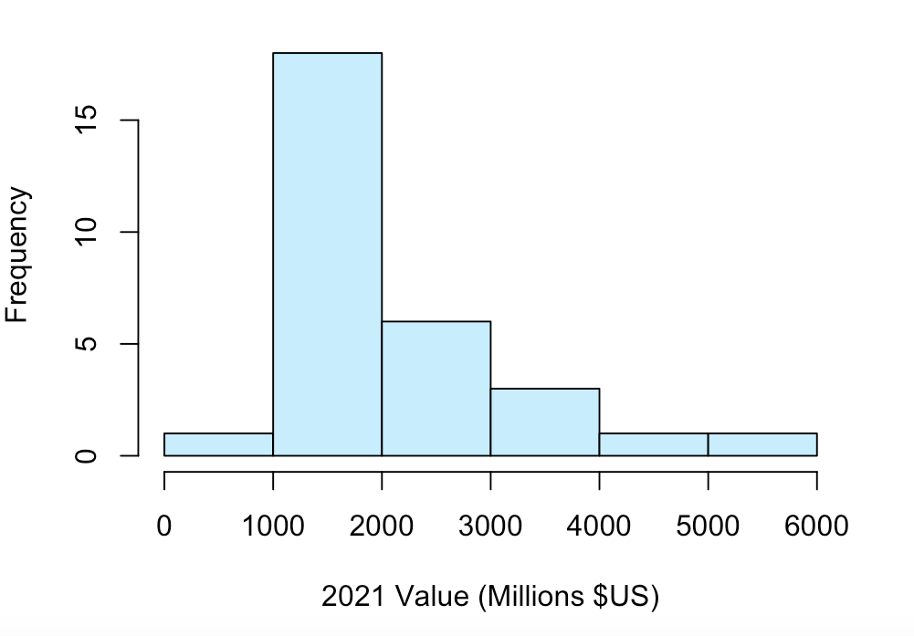
Initial Findings
Nearly a $5.1B difference in 2021 vs 1.85B in 2012!
(Yankees vs. Marlins 2021)
(Yankees vs. Rays 2012)
Large spread of values with skewed distribution

Slide 14
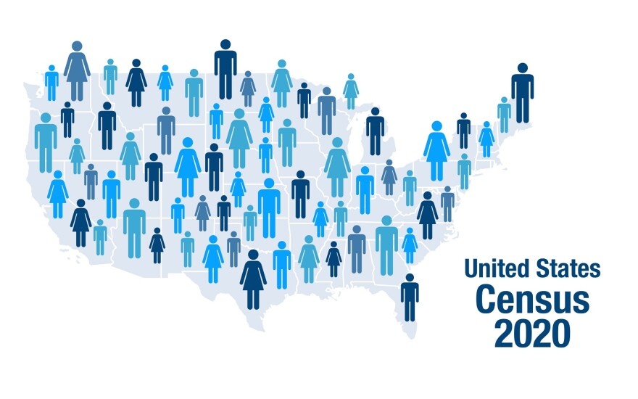
Census Housing Income Dataset
Census Income Dataset
364,998 rows by 111 columns, by far our largest dataset (10 years worth of census data)
Dataset has been mostly cleaned
Data collected on families, married couple households, nonfamily households, as well as breakdowns of income level
Skewed to the right, normalization will likely be required for analysis
Census Income Dataset
Merge the datasets together using the year attribute
City attribute will need to be brought in
Toronto as an MLB data point will need to be removed
This will be our most difficult dataset to clean with so many attributes
Notes:
The biggest challenge will be deciding which attributes are important for analysis and modeling
Luckily, the dataset has been partially cleaned already. Symbols have been removed and the years have been appended together
Upon initial inspection, every single attribute has a skew to the right; normalization of the data will likely be required
Additional data may need to be found to add a city element so we can conduct analysis on each MLB city with a current team

Slide 15
Related Research Articles

Slide 16
Related Research Articles
In Lee’s study (2), the sequential test method was used to identify the common factors in MLB attendance with data from 1904 to 2012. Both team-specific factors (performance) and economic factors (per capita GDP) were tested using sequential test method and found that per capita GDP was among the significant factors in different models. And it was concluded that the combination of time trend and per capita GDP is likely to be a common factor influencing attendance at MLB.
Thus this study provides evidence and base for our further study in housing and income data for MLB attendance and expansion.
2.) Common Factors in Major League Baseball Game Attendance. Journal of Sports Economics. 2018 Young H. Lee

Slide 17
Related Research Articles
However, another study (3) has suggested that, income is often found not to be a significant determinant of attendance, possibly because of the lack of variation over the league’s season or because it is not a good measure of the purchasing power and economic circumstances of the fans.
The coincident indexes have an advantage over income per capita because they vary by month within the season and because they combine information from several indicators so they can better reflect the current economic conditions. Using 4,696 games during the 2008 and 2009 seasons, the study investigated the effect of the economic crisis on attendance in MLB. The deteriorating economic circumstances explain a decline of about 6% compared to the reported decline of 6.77%.
However, this study also pointed out that there were limitations to this study such as the lack of weather data and playoff uncertainty.

Slide 18
Related Research Articles
Hence, in these two articles, income related variables were studied and different conclusions were drawn. Our study will use these as evidence and base to further examine how the housing and income data influence MLB attendance and use it for making MLB expansion decisions.
3.) An Examination of the Effects of the Recent Economic Crisis on Major League Baseball (MLB) Attendance Demand
. North American Association of Sports Economists. 2011. Sung Il Hong, Michael Mondello, and Dennis Coates

